Slide 1


DOCKER ASSIGNMENT
Presented By : DEEKSHA TRIPATHI

Slide 2
AGENDA
Introduction related to Tools & Technologies.
Create a Jenkins pipeline to deploy application present at: https://github.com/knoldus/node-hello
Use any type of Jenkins project.
Required command to run the application and the ports being used are present in the Github repository.
The application should be containerized and should be running on docker.
The image has to be pushed on Docker Hub and should be pulled for running.
The ports of the application should be open for communication and accept connection on the host machine.
Implement use of Global Tools Configuration to use Node JS effectively
The validations can be performed by hitting endpoints: <VM_IP>:3000 or <VM_IP>:3001

Slide 3
INTRODUCTION
Tools & Technologies
In this we used :
Amazon AWS
Jenkins
Docker
Amazon AWS: AWS (Amazon Web Services) is a comprehensive, evolving cloud computing platform provided by Amazon that includes a mixture of infrastructure as a service (IaaS), platform as a service (PaaS) and packaged software as a service (SaaS) offerings.
Jenkins: Jenkins is an open-source automation tool written in Java with plugins built for Continuous Integration purposes. Jenkins is used to build and test your software projects continuously making it easier for developers to integrate changes to the project, and making it easier for users to obtain a fresh build.
Docker: Docker is an open platform for developing, shipping, and running applications. Docker enables you to separate your applications from your infrastructure so you can deliver software quickly. With Docker, you can manage your infrastructure in the same ways you manage your applications.

Slide 4
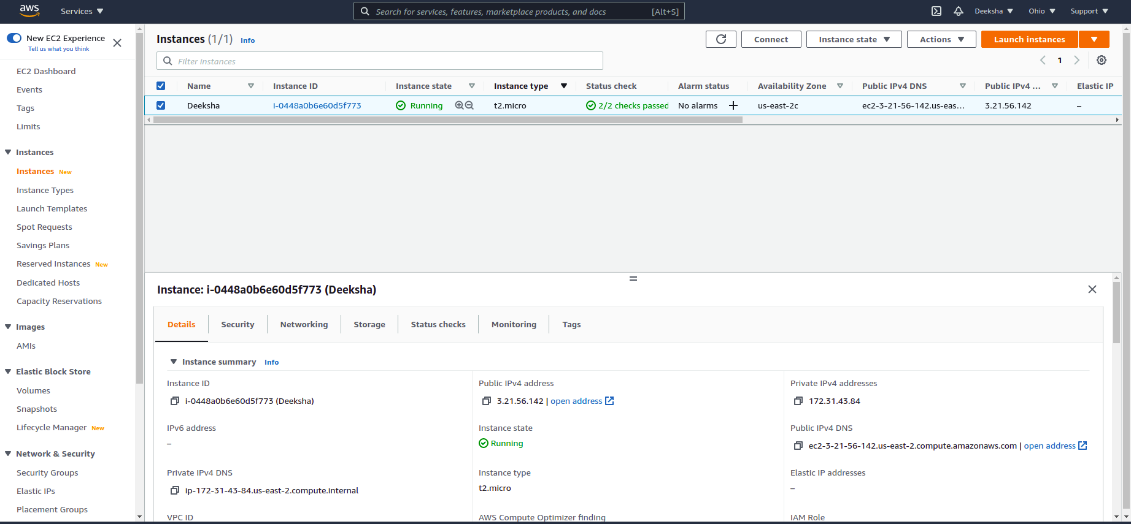
Create a Jenkins pipeline to deploy application present at: https://github.com/knoldus/node-hello and use any type of Jenkins project.
Creating an Instance at AWS Account

Slide 5
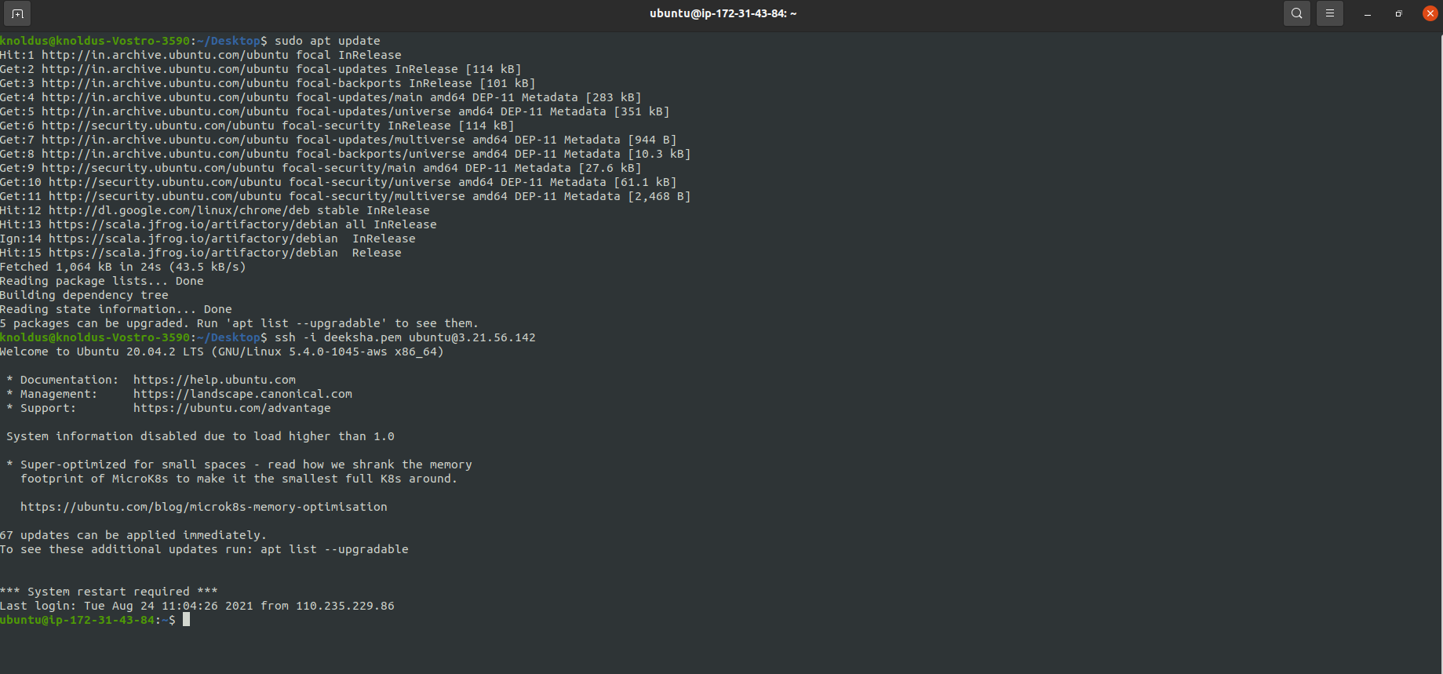
Create a Jenkins pipeline to deploy application present at: https://github.com/knoldus/node-hello and use any type of Jenkins project.
Accessing VM from the System
Accessing VM

Slide 6
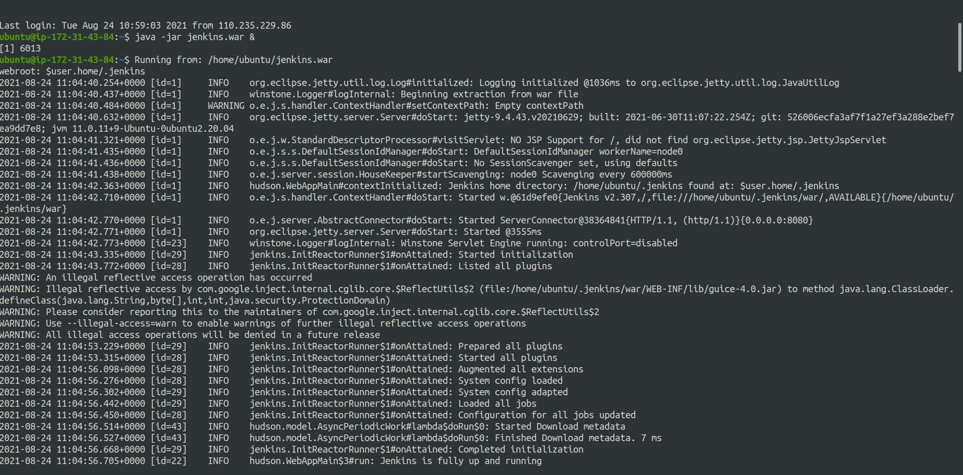
Create a Jenkins pipeline to deploy application present at: https://github.com/knoldus/node-hello and use any type of Jenkins project.
Running Jenkins in the Terminal
Running Jenkins

Slide 7
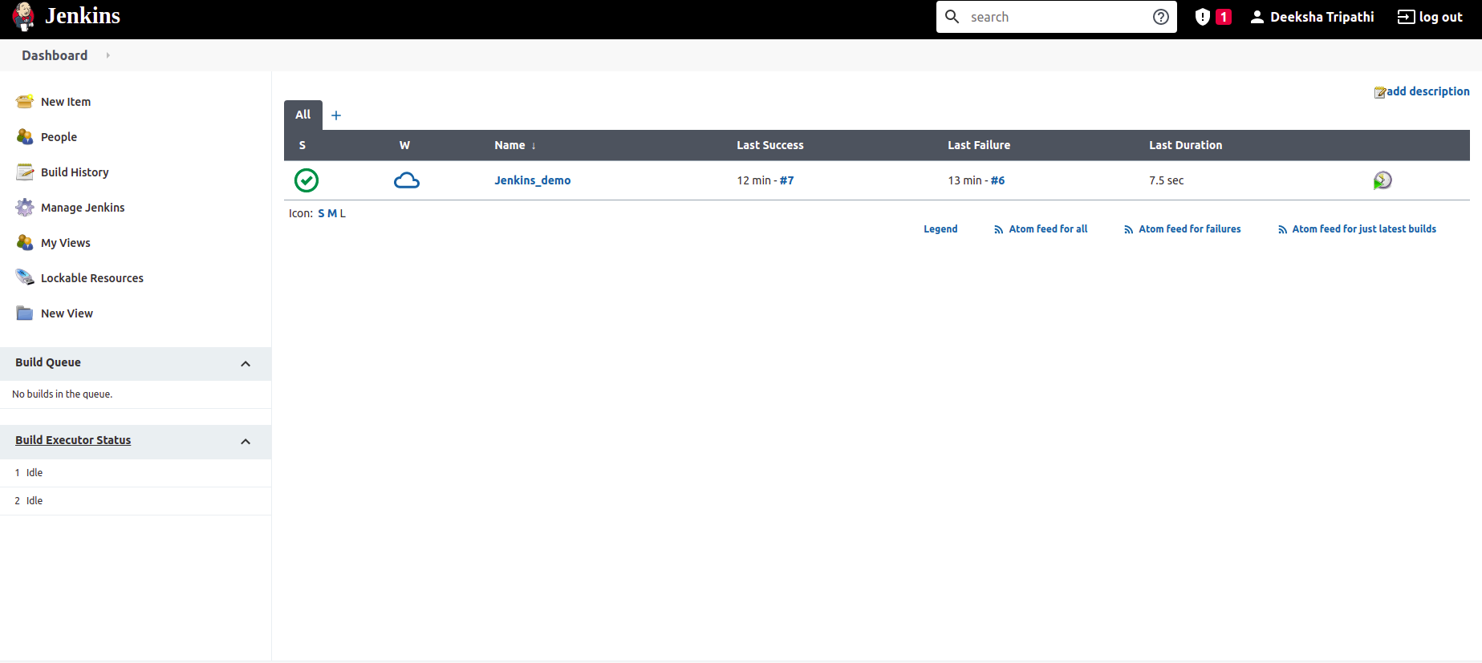

Create a Jenkins pipeline to deploy application present at: https://github.com/knoldus/node-hello and use any type of Jenkins project.
Creating new project on Jenkins
Creating New Project On Jenkins

Slide 8
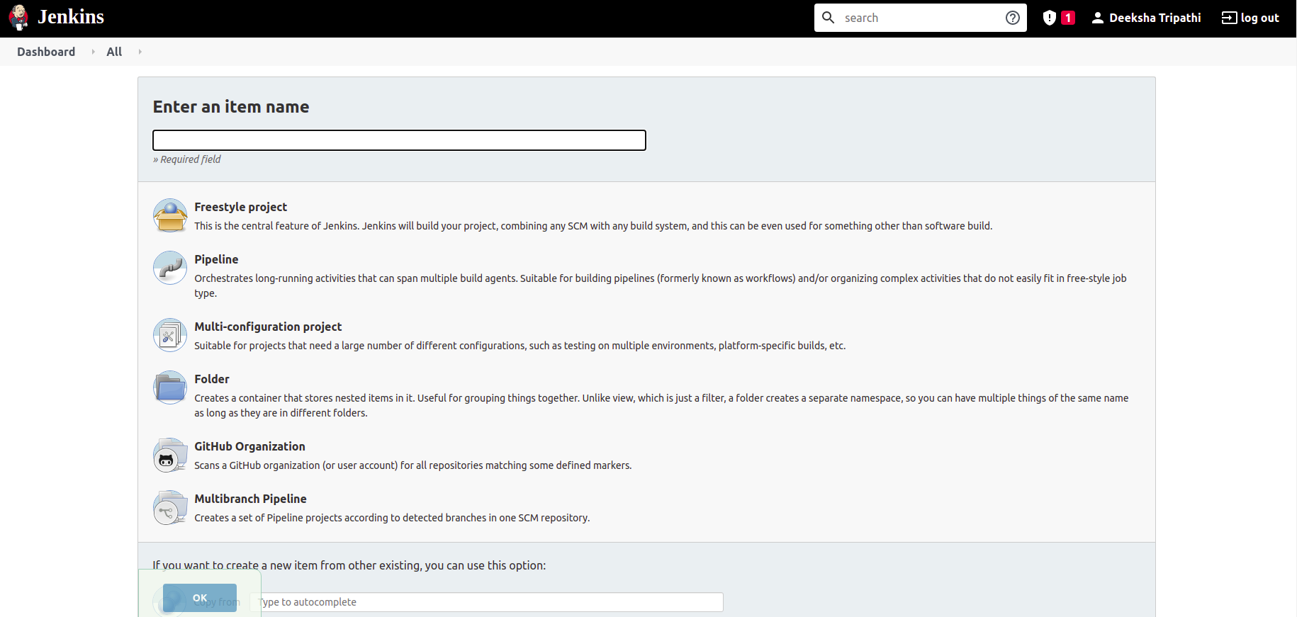
Create a Jenkins pipeline to deploy application present at: https://github.com/knoldus/node-hello and use any type of Jenkins project.
Enter the name of your project
Choose Freestyle project

Slide 9
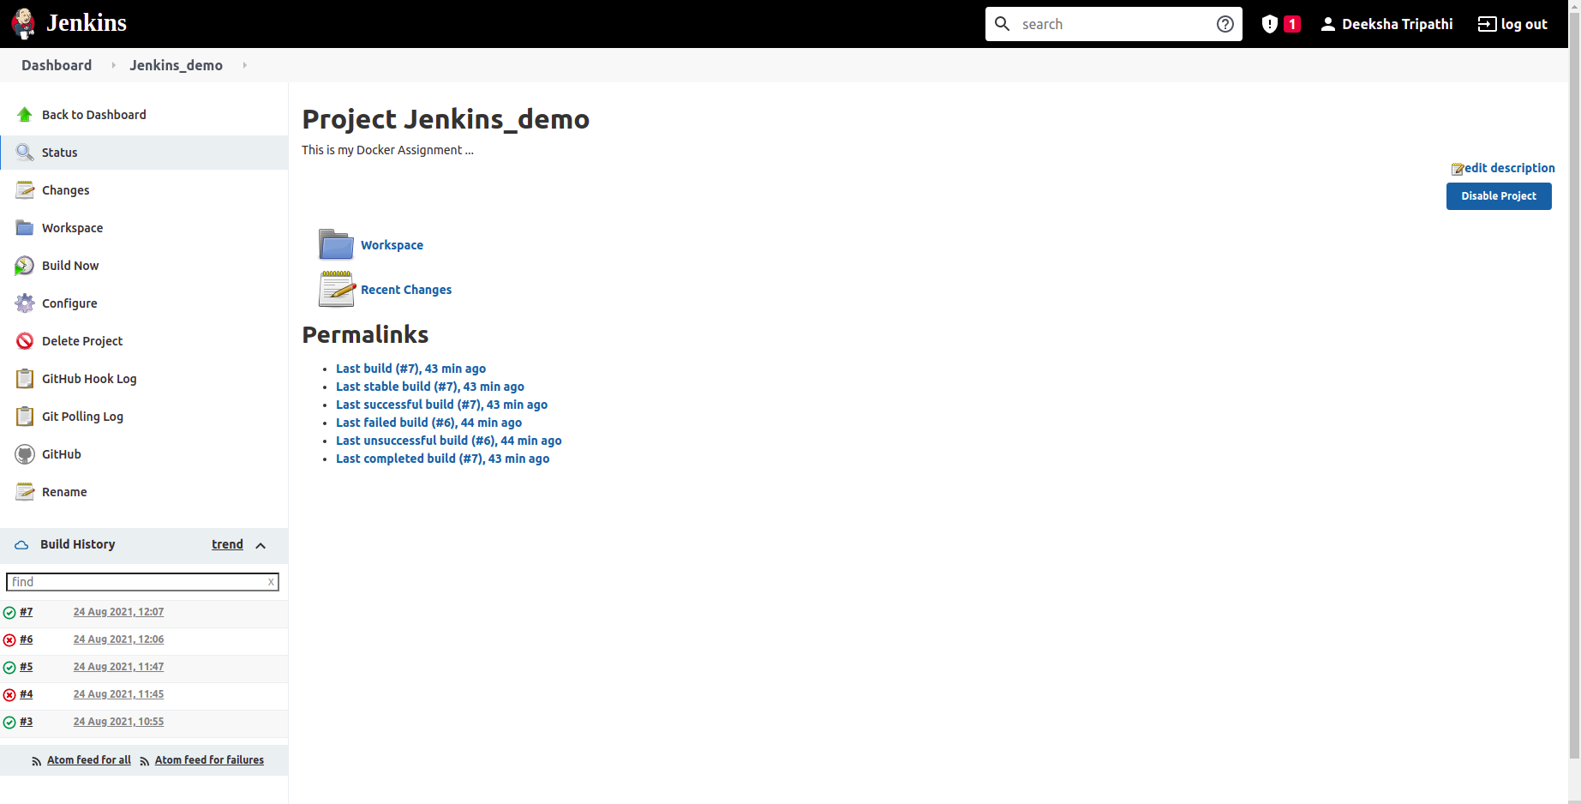
Required command to run the application and the ports being used are present in the Github repository.
Configuring the Jenkins Pipeline
Configuring the Jenkins Pipeline

Slide 10
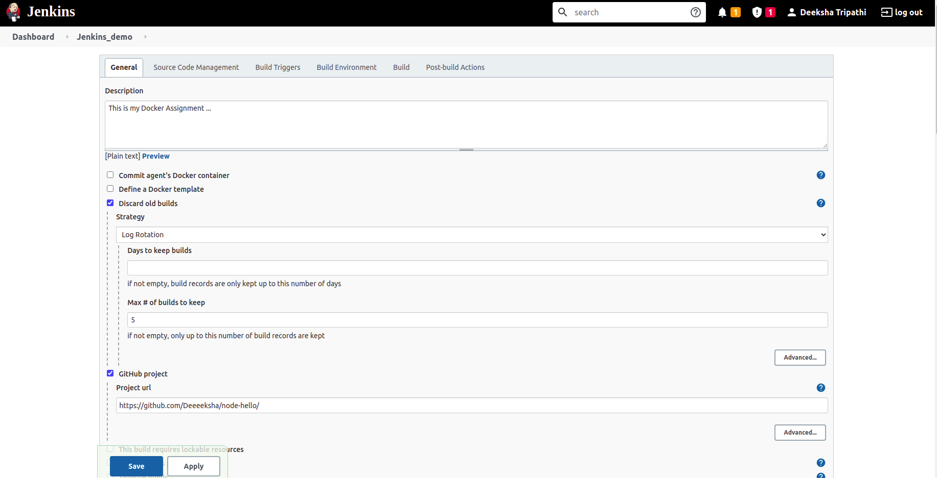
Required command to run the application and the ports being used are present in the Github repository.
Configuring Steps Of Jenkins

Slide 11
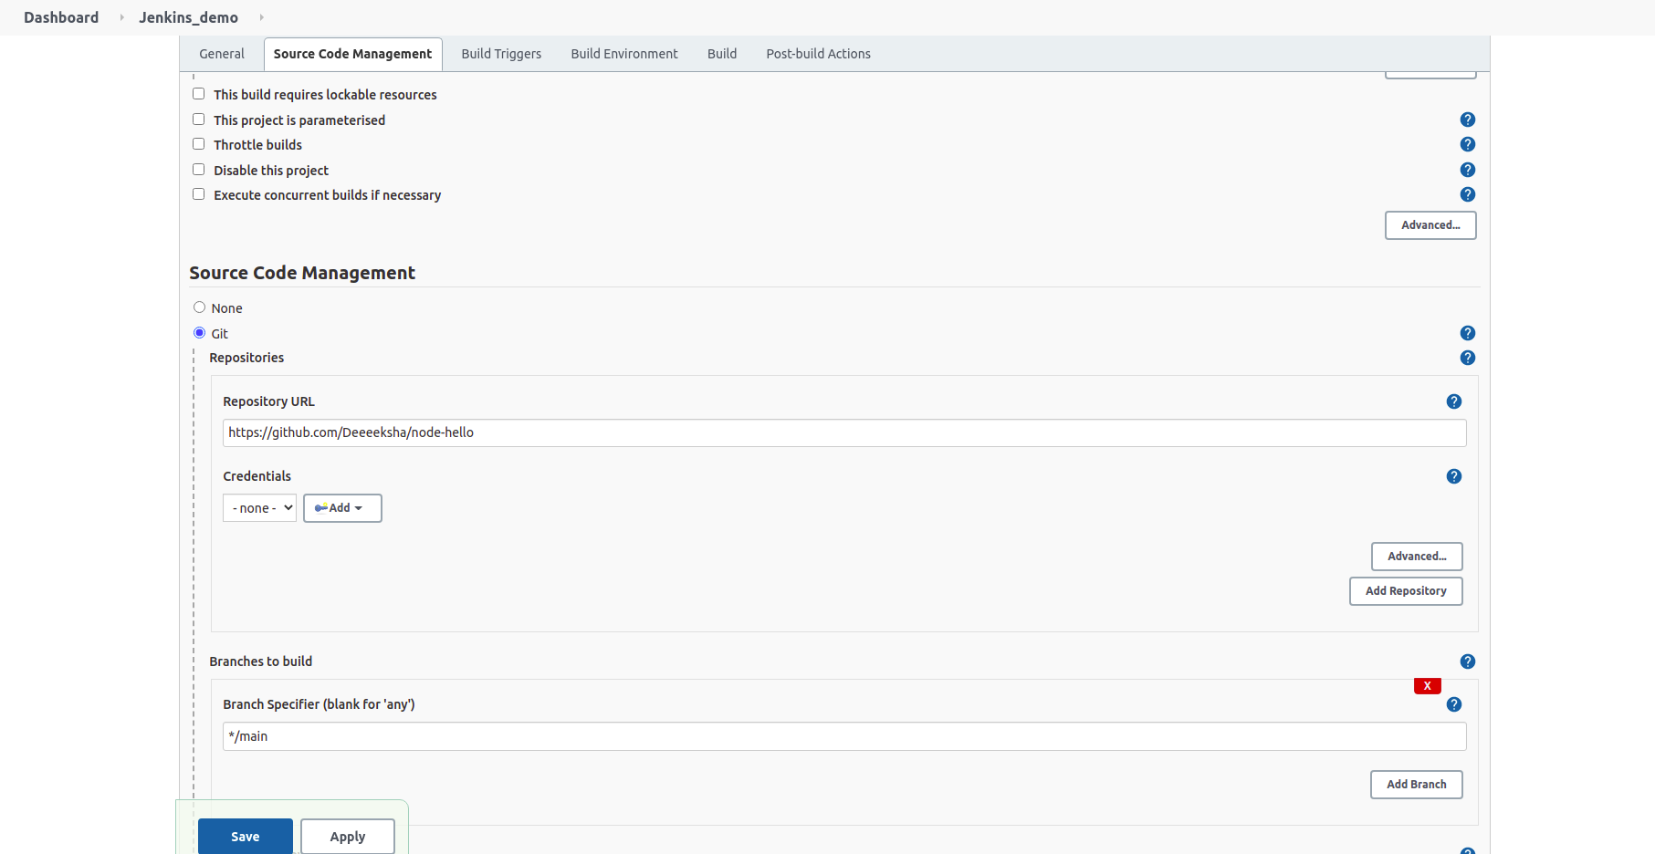
Required command to run the application and the ports being used are present in the Github repository.
Configuring Steps Of Jenkins

Slide 12
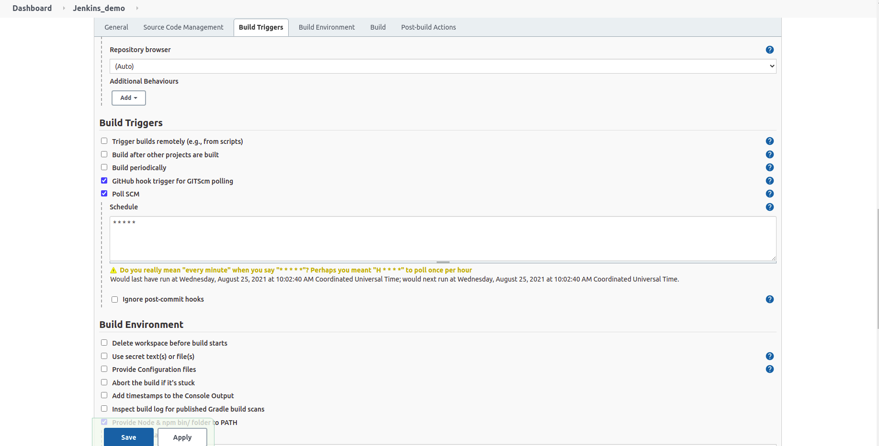
Required command to run the application and the ports being used are present in the Github repository.
Configuring Steps Of Jenkins

Slide 13
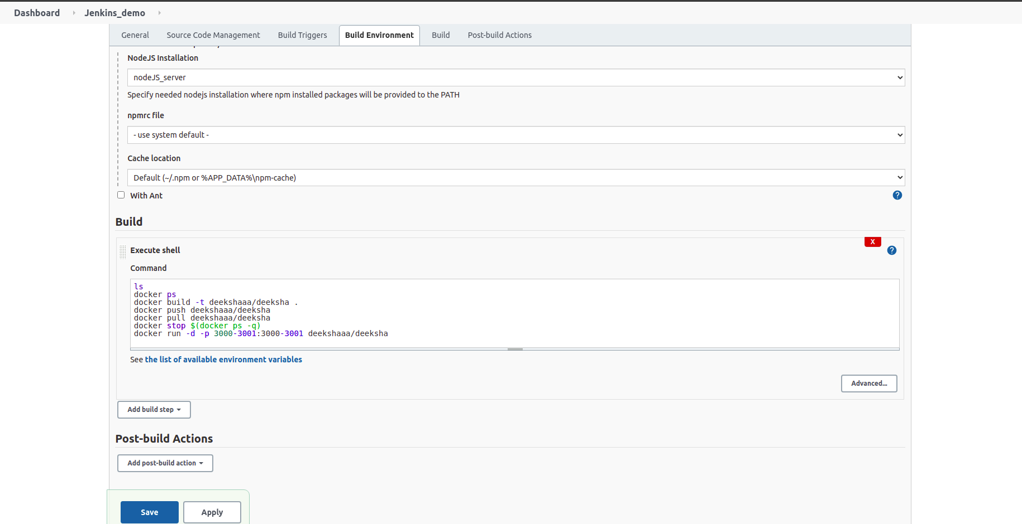
Required command to run the application and the ports being used are present in the Github repository.
Configuring Steps Of Jenkins

Slide 14
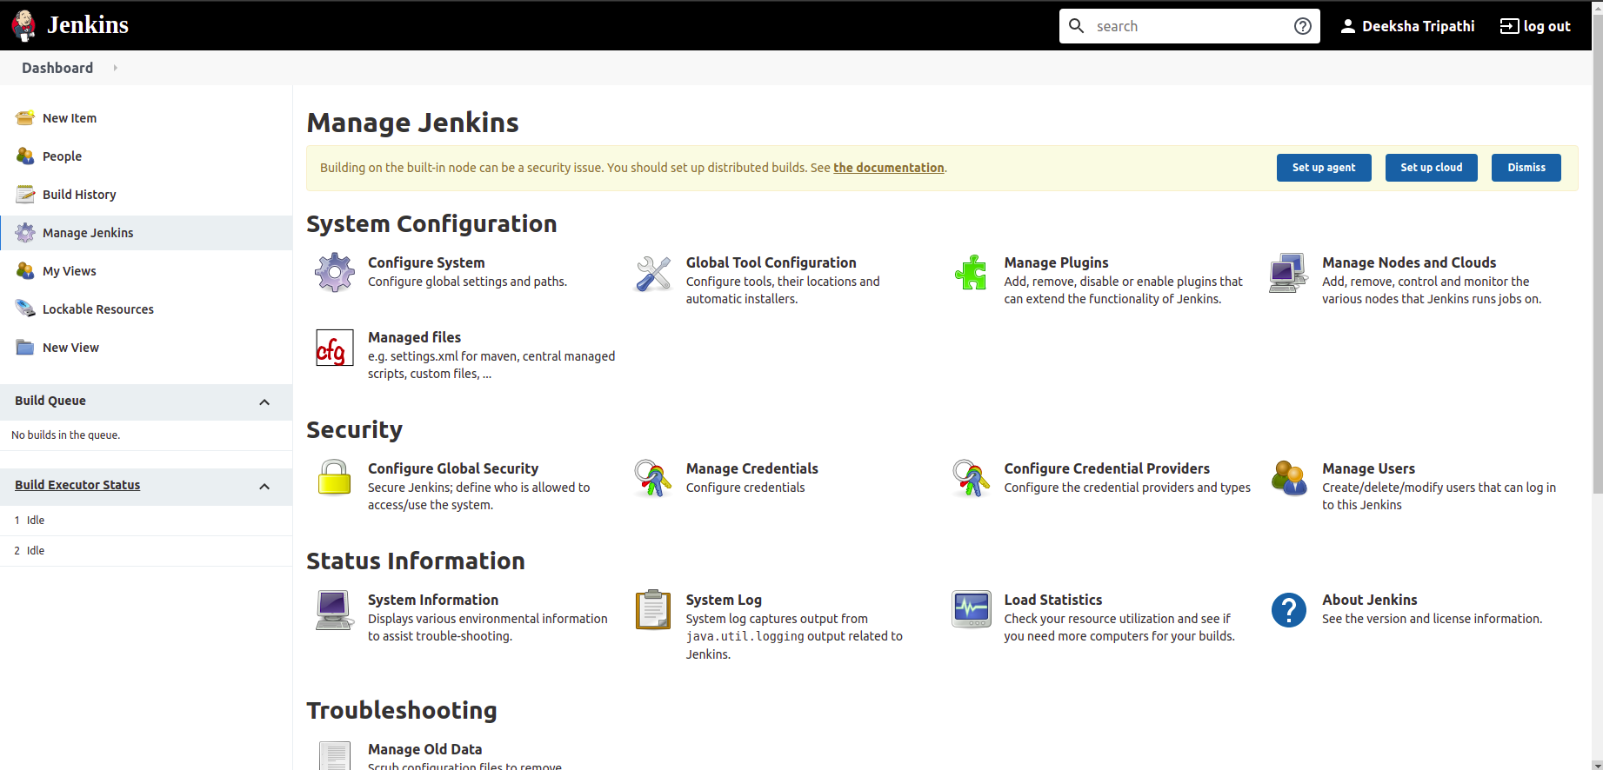
Required command to run the application and the ports being used are present in the Github repository.
Installing Jenkins Plugins
In Manage Jenkins Tab; Select Manage Plugins Option

Slide 15
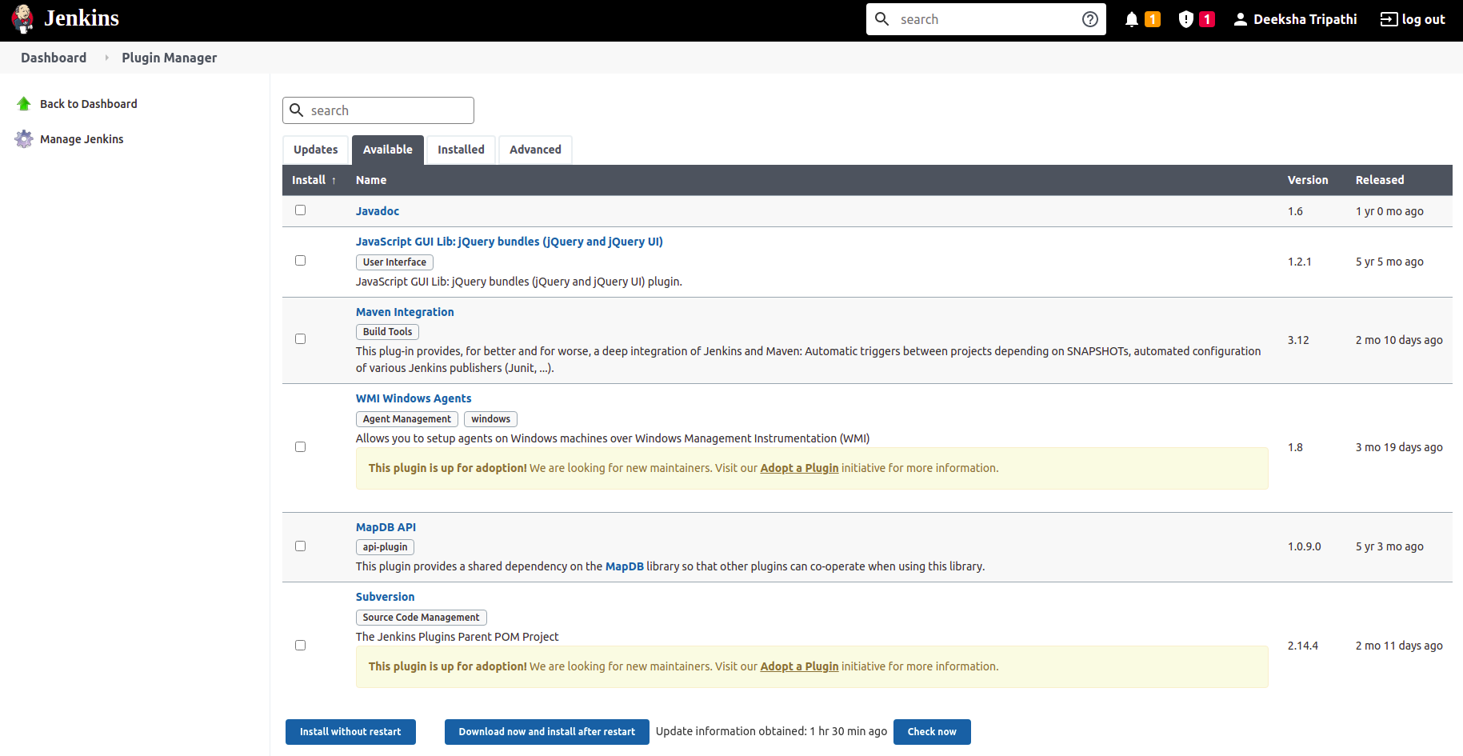
Required command to run the application and the ports being used are present in the Github repository.
Installing Jenkins Plugins
Select the Plugins need to be installed and install them like NodeJs & Docker

Slide 16
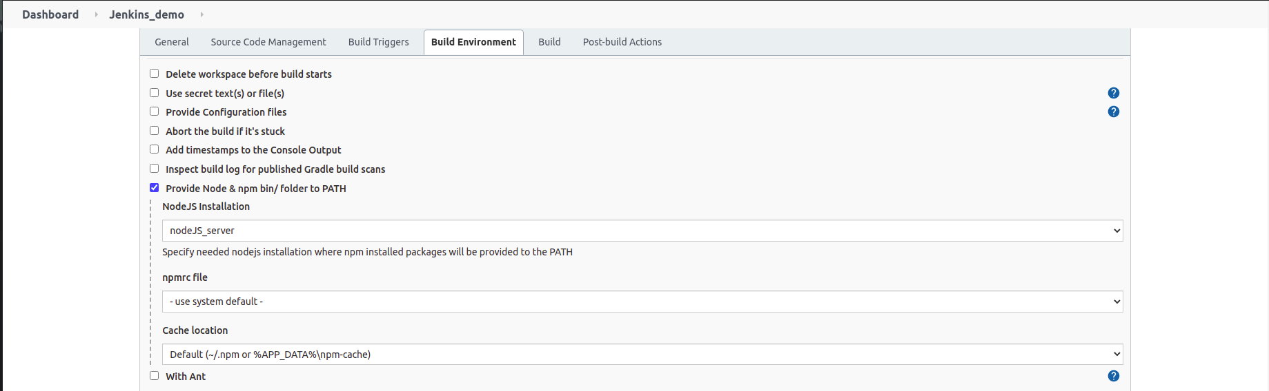
Required command to run the application and the ports being used are present in the Github repository.
Adding NodeJs in the Jenkins Pipeline

Slide 17
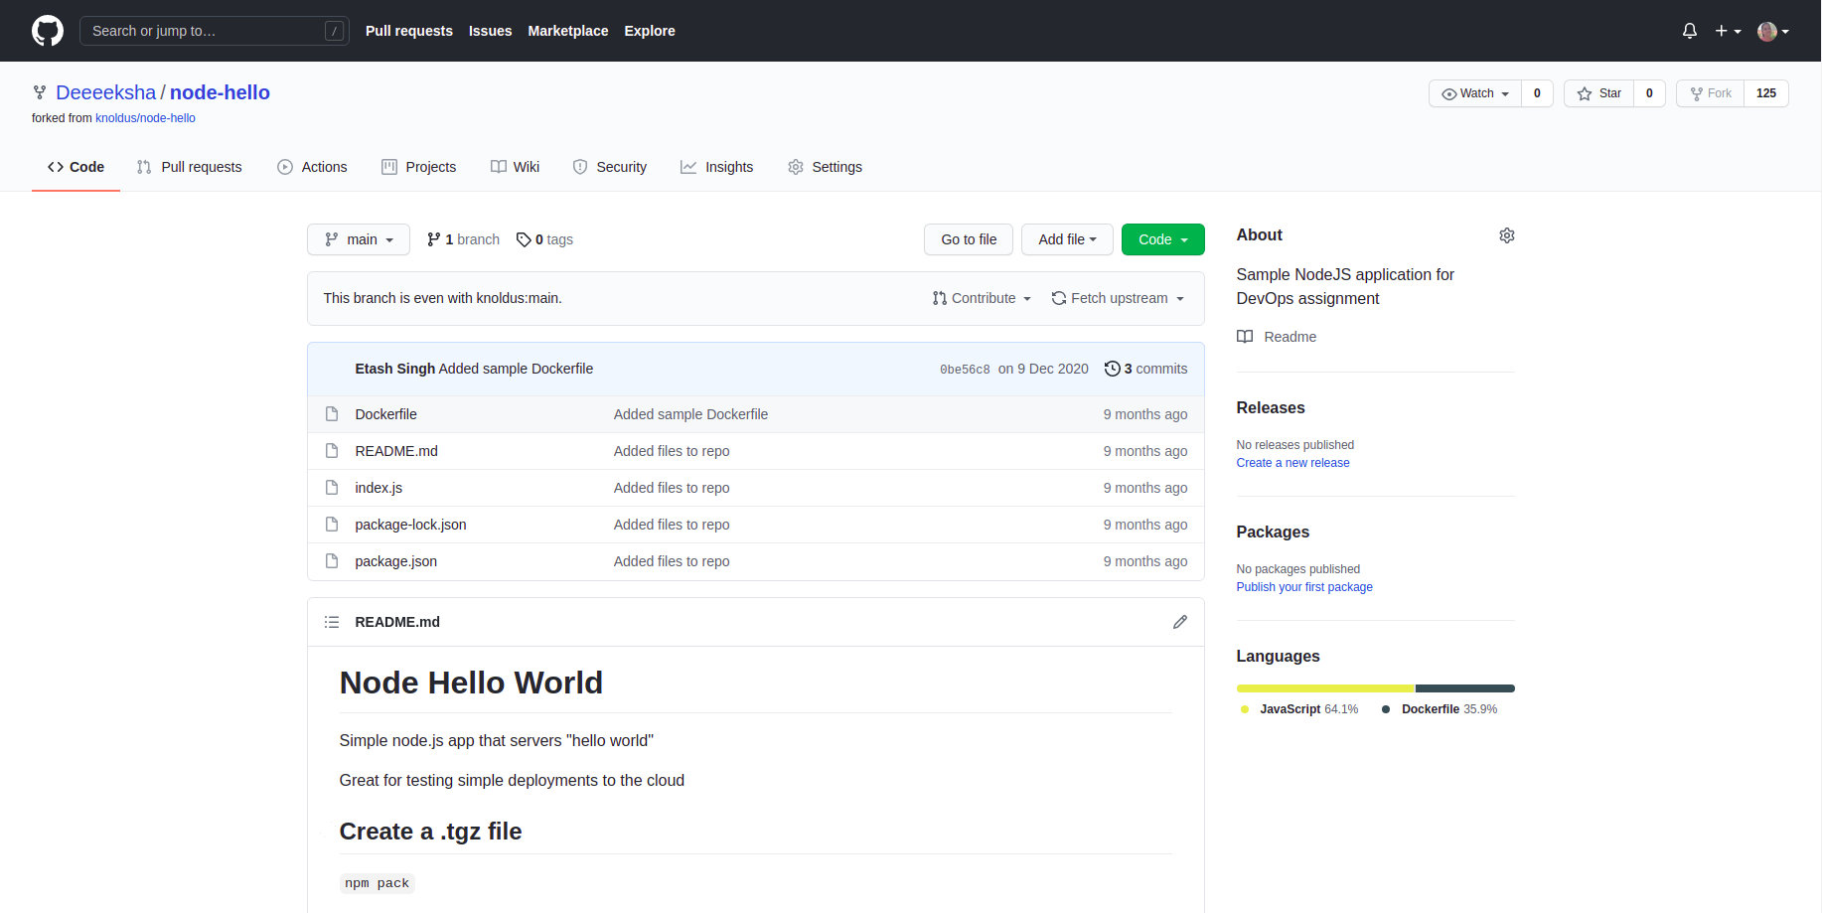
Required command to run the application and the ports being used are present in the Github repository.
Github Repository

Slide 18
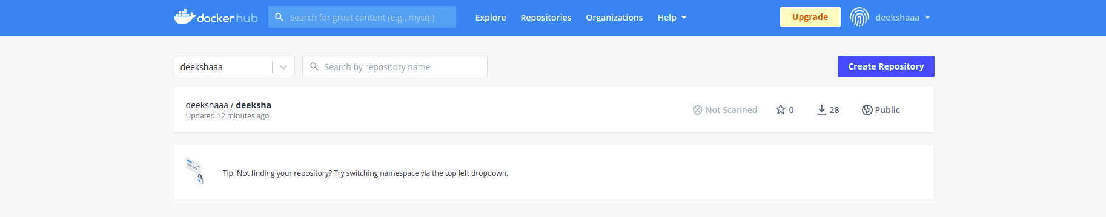
The application should be containerized and should be running on docker.
Creating Account at Docker Hub & making a Container

Slide 19
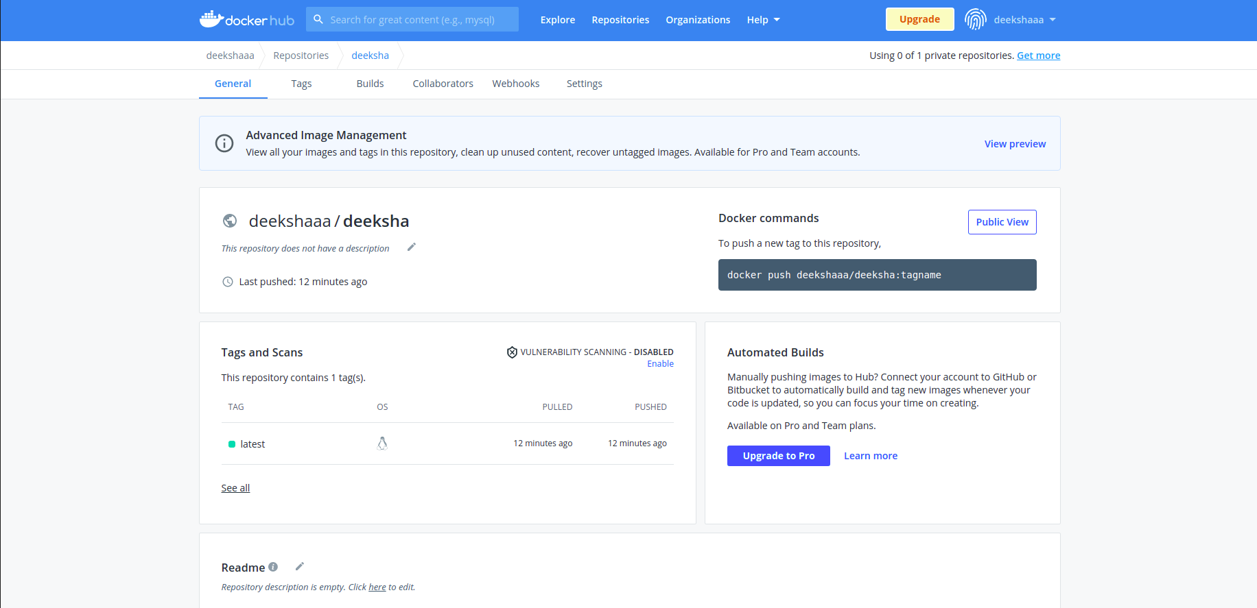
The application should be containerized and should be running on docker.
Creating Account at Docker Hub & making a Container

Slide 20

The application should be containerized and should be running on docker.
Commands used in Docker

Slide 21
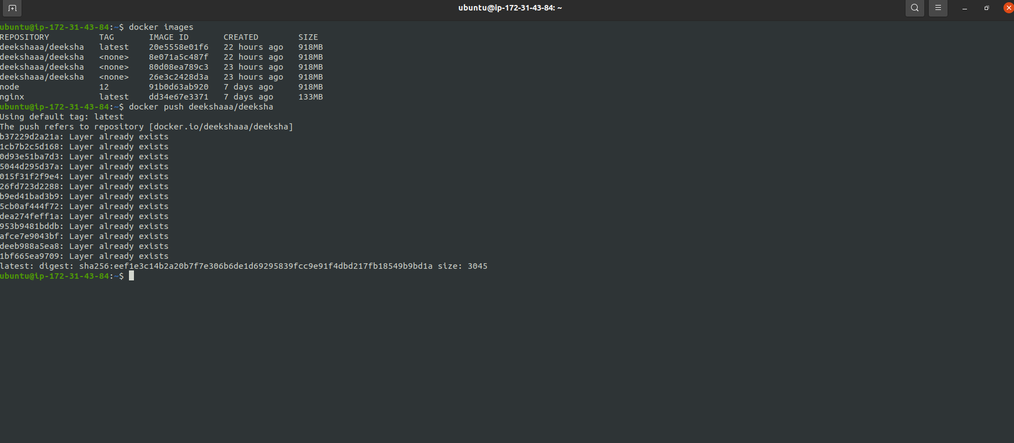
The image has to be pushed on Docker Hub and should be pulled for running.
Images pushed in the Docker Hub and after that Pulled from Docker Hub
Details about all the images in Docker Container
￼
To push the images in the Docker Hub

Slide 22
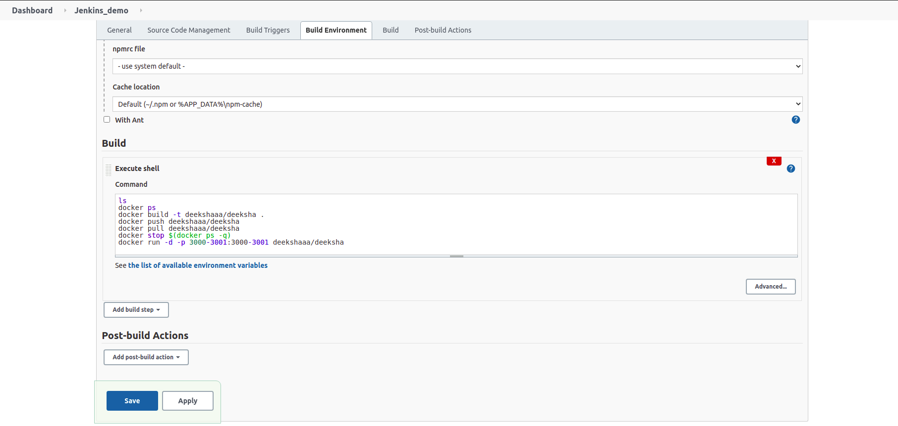
The image has to be pushed on Docker Hub and should be pulled for running.
Shell Commands to Executes the Ports and Pull from Docker at Run-Time
Shell Commands

Slide 23
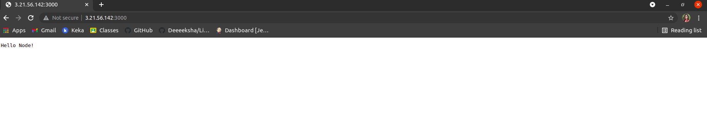
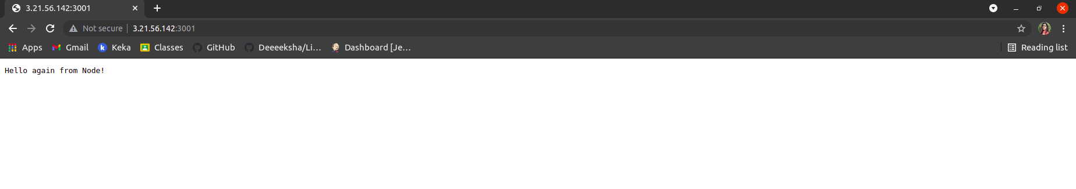
The ports of the application should be open for communication and accept connection on the host machine.
Ports are working and running on different systems
Port 3000 is working in any system
Port 3001 is working in any system

Slide 24
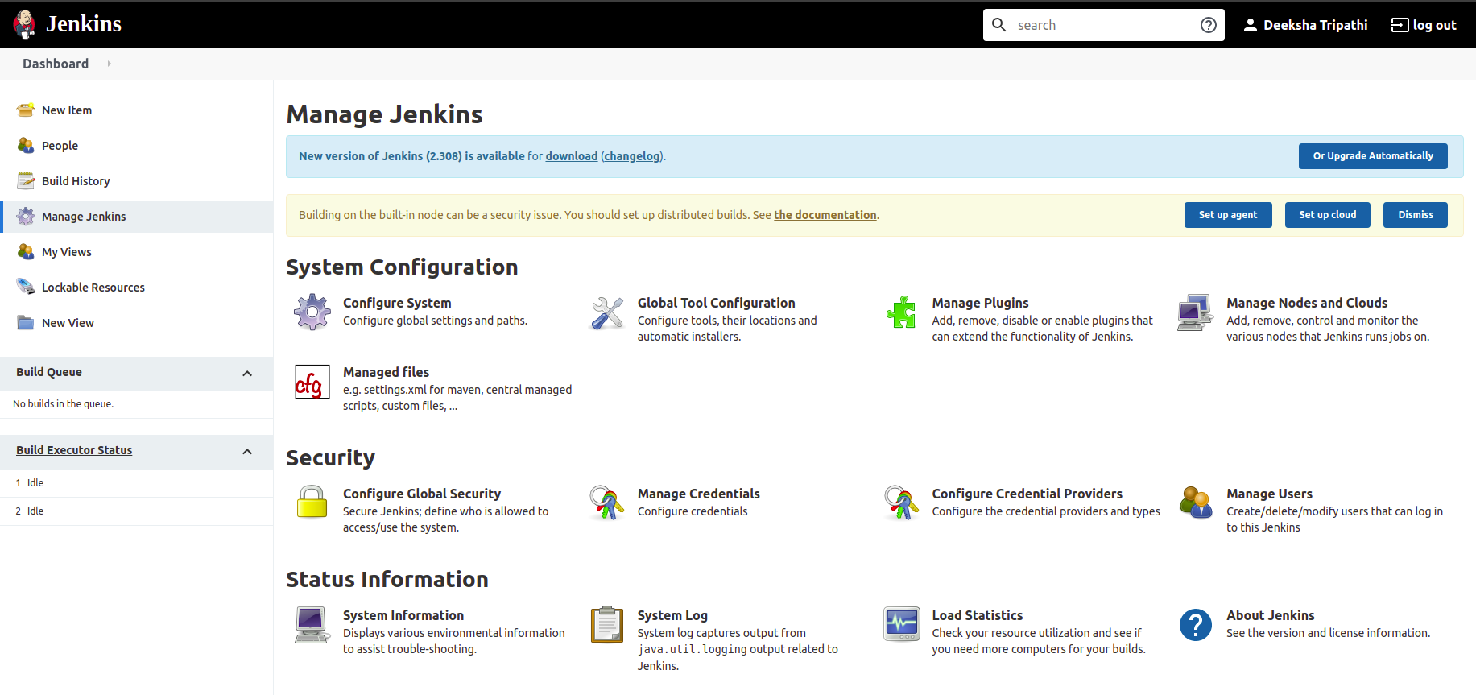
Implement use of Global Tools Configuration to use Node JS effectively
Implementing Global Tool Configuration in Jenkins
In Manage Jenkins Tab; Select Global Tool Configuration

Slide 25
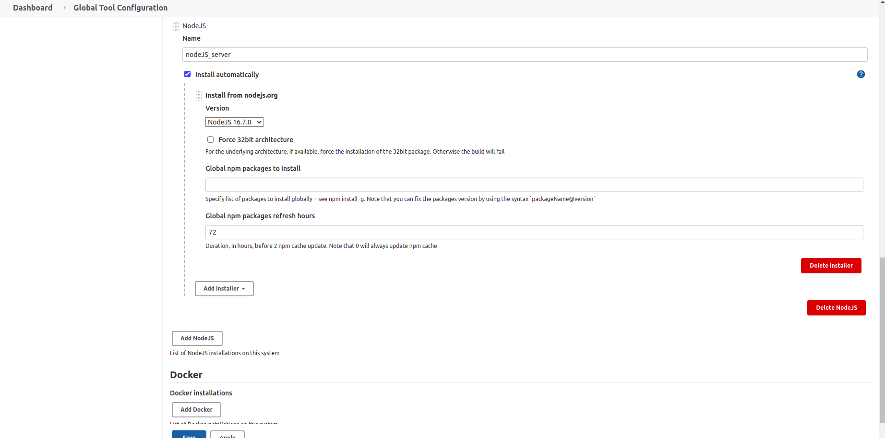
Implement use of Global Tools Configuration to use Node JS effectively
Adding NodeJs Configuration
Adding NodeJs in Global Tool Configuration

Slide 26
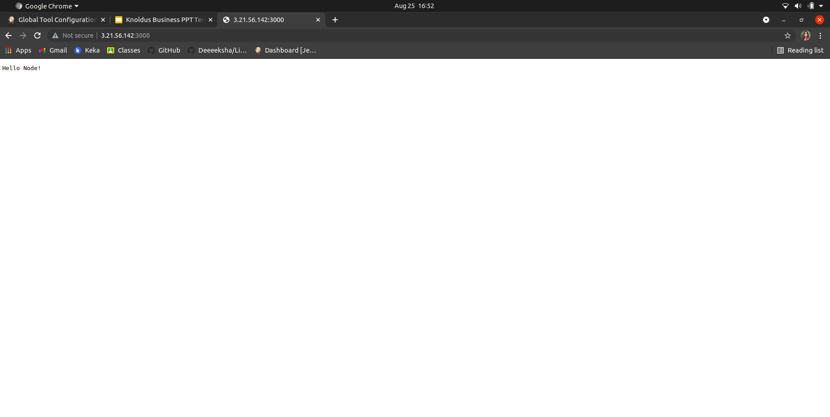
The validations can be performed by hitting endpoints: <VM_IP>:3000 or <VM_IP>:3001
Validation of <VM_IP>:3000 Port

Slide 27
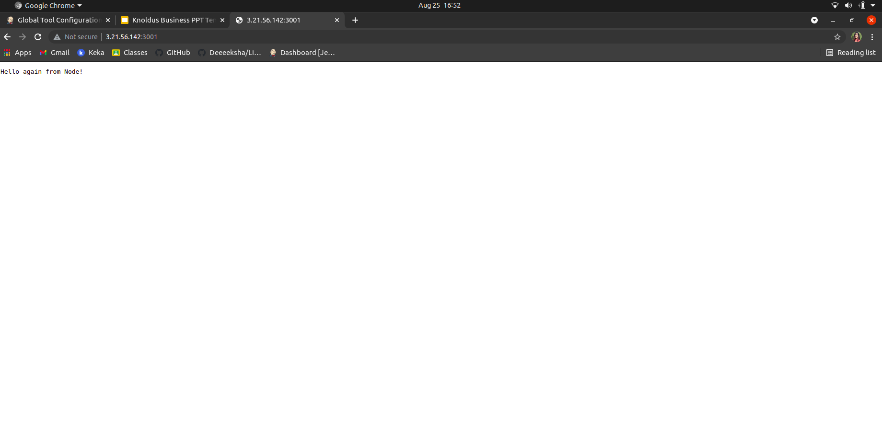
The validations can be performed by hitting endpoints: <VM_IP>:3000 or <VM_IP>:3001
Validation of <VM_IP>:3001 Port

Slide 28

Thank You!

